Slide 1
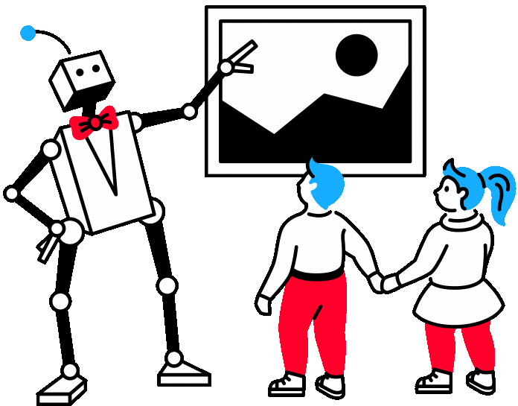

„Do Robots Drink Water?
Teaching Sustainable AI Through Digital Vocabulary”
Rita Mozūraitienė
Klaipėdos Tauralaukio progimnazija

Slide 2
AIM:
To develop sustainable awareness about AI water consumption through digital vocabulary learning.
OBJECTIVES:
Students will be able to:
• use topic-related vocabulary (water, cooling, energy, save)
• calculate simple water consumption amounts
• suggest solutions to reduce water use
• present ideas using simple English sentences

Slide 3
DEVELOPED COMPETENCIES
• Communication in English
• Critical thinking
• Problem-solving
• Environmental awareness
• Digital literacy
• Collaboration

Slide 4
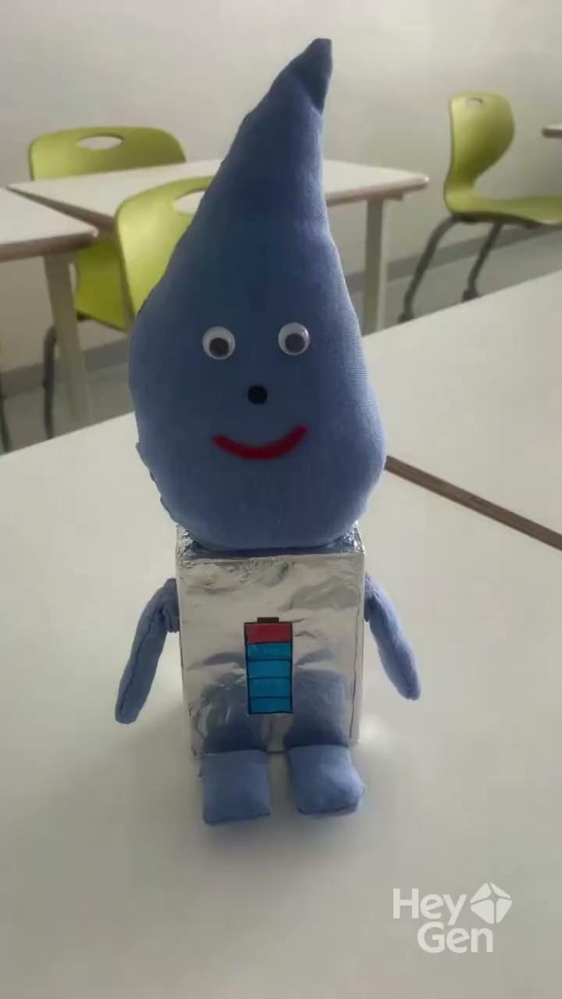
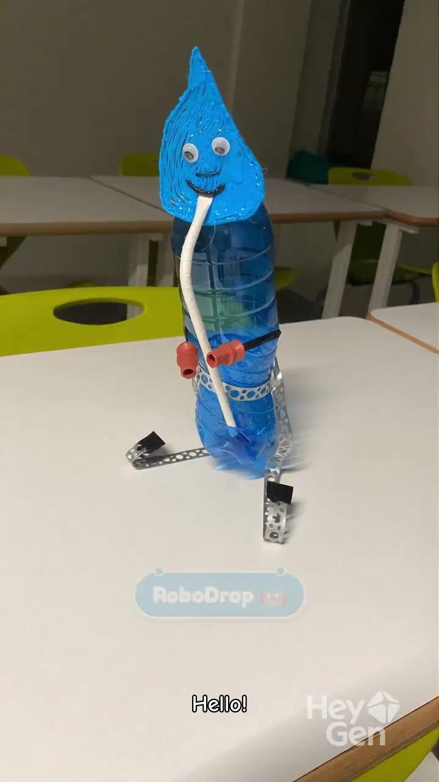
SPEAKING MASCOTS
https://app.heygen.com

Slide 5
SAFER INTERNET WEEK
https://dashboard.blooket.com/set/6997689599033007454b69ff

Slide 6
FLASHCARDS: ROBOTS and WATER
https://dashboard.blooket.com/set/699893213ce80cb9d61e53ec
https://quizlet.com/1146237617/how-much-water-do-robots-drink-flash-cards/?i=5a9b8c&x=1jqt

Slide 7
🌍 WATER FOOTPRINT CHALLENGE
❄️ Cooling
💧 20 ml
🧼 Cleaning
💧 15 ml
🔋 Charging Batteries
💧 10 ml
⚡ Making Energy
💧 25 ml

Slide 8
🌍 ROBOT USES:
20 ml for cooling
15 ml for cleaning
25 ml for energy
10 ml for charging
Total: ______ ml

Slide 9
🌍 PROBLEM
How to reduce the consumption of water?

Slide 10
🌍 PROBLEM SOLUTION
Our robot uses ______ ml of water.
This is too much.
We can save water by:
_1._______________________________________
_2._______________________________________

Slide 11
🌍 ROLE-PLAY
👩‍🔬 Scientist
🤖 Robot engineer
🌍 Environmental activist
🏭 Factory manager
Explain why your robot needs water.
Explain how to use less water.

Slide 12
🌍 REFLECTION
  Why is water important?
  Do robots really “drink” water?
  Is AI always good for the planet?
  Should we limit AI use?
  How can we save water in real life?

